Slide 1
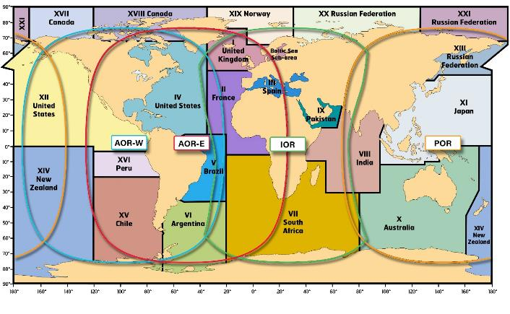
WWNWS-SC Report to the IHO-IRCC 11
Inter-Regional Coordination Committee
Mr. Peter Doherty, Chair WWNWS-SC

Slide 2
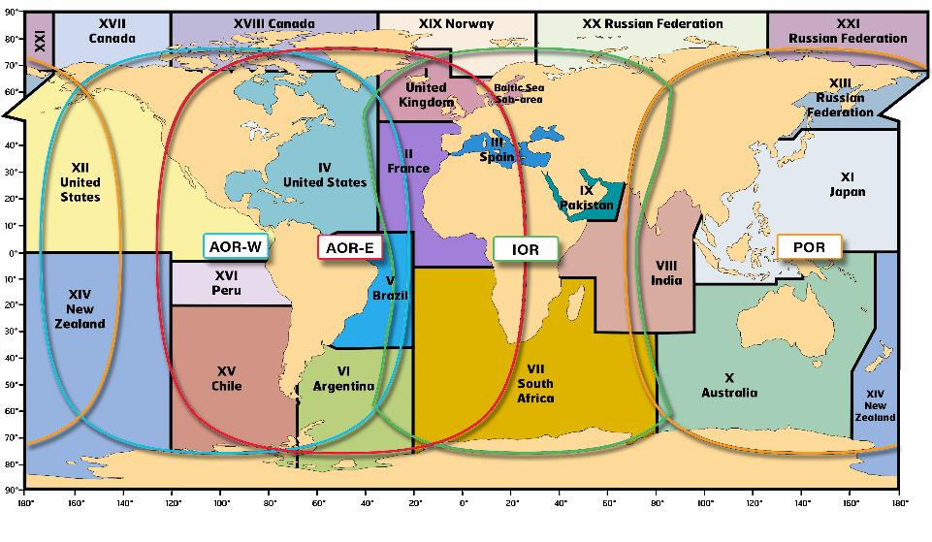
Principal Activities
WWNWS background
WWNWS10 meeting
Inmarsat I3-I4 satellite migration / Inmarsat enhancements
IMO - Navigation, Communications, and Search and Rescue Subcommittee meeting (NCSR6)
IMO/IHO/WMO Document Review Working Group (DRWG17)
MSI in a multi-satellite environment
National Coordinator support
MSI training
Future work
Actions

Slide 3
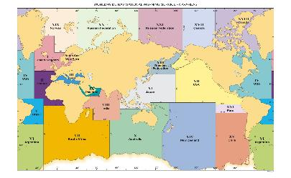
WWNWS Background
The World-Wide Navigational Warning Service (WWNWS) is the internationally and nationally coordinated service for the promulgation of hazards to navigation – navigational warnings – which may endanger international shipping
WWNWS-SC monitors and guides IHO/IMO WWNWS including 21 NAVAREA Coordinators
Responsible for proposing new methods to enhance the provision of navigational warnings.
Provide appropriate guidance to IHO Member State Representatives.
IMO approval/oversight
IHO-SC with dual approval/oversight
Close liaison maintained with WMO for WWMIWS and METAREA Coordinators

Slide 4
WWNWS 10 Meeting
10th meeting in Monaco 27-31 August 2018.
Attendees:
48 delegates from 21 IHO Member States and supporting organizations
21 delegates from the WWMIWS
Secretariat of the World Meteorological Organization (WMO)
Secretariat of the International Mobile Satellite Organization (IMSO)
Chairs of IMO NAVTEX and International SafetyNET Coordinating Panels
Inmarsat
Iridium
Security of Navigation, Stabilisation, Advice and Training (including AWNIS) (SONSAT)
IHO Secretariat
The delegates included representatives of 18 NAVAREA Coordinators, one Sub-Area Coordinator and six National Coordinators.
Inmarsat satellite migration, I3-I4; new coverage footprints
Inmarsat SafetyNET enhancements (SafetyNET II)
IMO International SafetyNET Coordinating Panel name change
Document Review (IMO Resolution A.705 (MSI), A.706 (WWNWS), A.1051 (Met-Ocean Information and Warning Service), SafetyNET Manual)
Iridium as a new recognized mobile satellite service (RMSS)
Development of a user manual

Slide 5
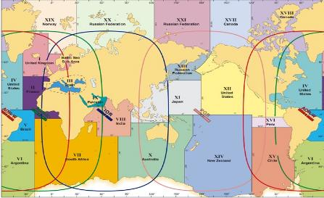
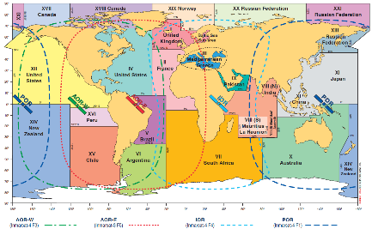
Inmarsat I3-I4 Satellite migration
I3 Coverage
Migrate to new, more capable I4 satellites—coverage shift
Migration started 9 May 2018 and completed on 12 December 2018
New coverage required NAVAREAs/METAREAs to modify broadcast procedures
Required notifications to ships
I4 Coverage

Slide 6
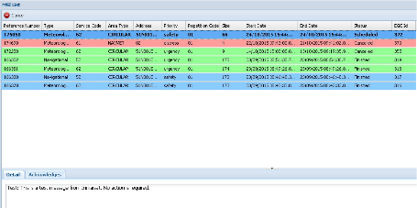
Inmarsat Enhancements
SafetyNET II
web-based user interface
broadcast over multi satellites
message monitoring and cancellation
no extra equipment needed

Slide 7
IMO NCSR6
IMO International SafetyNET Coordinating Panel name change
International EGC Coordinating Panel (NCSR 6/9/2)
Interim Iridium Manual (NCSR 6-INF.17)
IMO MSC Circular and with the goal to submit a final manual at NCSR8 in 2021
A.705(17), as amended - Promulgation of Maritime Safety Information
NCSR6 approved – Awaiting MSC 101 adoption
A.706(17), as amended - World-Wide Navigational Warning Service
NCSR6 approved – Awaiting MSC 101 adoption
A.1051(27) - World-Wide Met-Ocean Information and Warning Service.
NCSR6 approved – Awaiting MSC 101 adoption

Slide 8
Document Review Working Group 17
Interim Iridium Manual submitted for MSC approval
Service will be called “SafetyCAST”
Certificates of Authorization to be issued by IMO in 2019
Test and evaluation in 2019/20
Fully operational 2020-2021 timeframe
Revised - International SafetyNET Manual
Draft prepared
WWNWS11 to review and submit to NCSR7-2020

Slide 9
MSI via a multi-satellite environment
IMO approval of Iridium as a Recognized Mobile Satellite Service (RMSS)
Resource burden on Maritime Safety Information provider (NAV/MET):
Potentially double and triple the cost
Additional Personnel
Broadcasting challenges:
MSI providers use different processes (email, web, machine to machine) for broadcast
Requires RMSS to offer multi interface solutions (Email, web interface and have a common data interface standard)
Approval of additional satellite services?
BeiDou – Chinese Satellite navigation system proposal 2020
S-124 Impacts?

Slide 10
MSI Service Provider Within a multi-provider environment
Multi-provider terminal/receiver solution?
A terminal with two or more radios/transceivers
cost, manufacturer risk, complexity and antenna interference.
Determined not to be a viable solution.
Monitoring in a multi-provider environment
Satellite configuration
LEO vs Geostationary
easier when the information provider is inside the RMSS coverage footprint;
challenge when information provider is outside of the RMSS coverage footprint
RMSS must provide a solution that the WWNWS approves

Slide 11
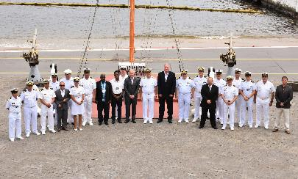
MSI Training
Objectives:
Endeavour to be informed of all events that could significantly affect the safety of navigation within their coastal region.
Assess all information in the light of expert knowledge for relevance to navigation in the coastal region.
Draft navigational warnings in accordance with the Joint IMO/IHO/WMO Manual on Maritime Safety Information
Pass NAVAREA warnings for further promulgation to the NAVAREA Coordinator
21 Courses
325 Students
119 Countries
Brazil 2018

Slide 12
MSI Training
2007 Jamaica (MACHC)
2007 Mozambique (SAIHC)
2008 Spain (MBSHC)
2009 Ghana (EAtHC)
2009 Oman (NIOHC / RSAHC)
2010 Namibia (SAIHC)
2010 Australia (SWPHC)
2011 Brazil (SWAtHC, SEPHC & MACHC)
2013 Trinidad (MACHC)
2013 Spain (MBSHC)
2013 South Africa (SAIHC)
2014 Oman (NIOHC / RSAHC)
2014 New Zealand (SWPHC)
2014 Ivory Coast (EAtHC)
2015 Japan (EAHC)
2015 Turkey (MBSHC)
2016 St. Lucia (MACHC)
2017 Barbados (MACHC)
2017 South Africa (SAIHC)
2018 New Zealand (SWPHC)
2018 Brazil (SWAtHC)
2019 Jakarta 9-13 Sep ???
2019 Mauritius 22-24 Oct

Slide 13
MSI Training
Support for a train-the-trainer opportunities

Slide 14
National Coordinator Support
Example from NAVAREA IV – 52 National Coordinators

Slide 15
Future Work
Continue process of editorial amendments to the WWNWS Guidance Documents/Manuals on MSI
Monitor developments in IMO regarding E-Navigation, S-124, AIS Aids to Navigation and GMDSS Modernization and their impact on the provision of navigational warnings to mariners at sea.
Provide appropriate advice and guidance to IMO, WMO and IHO through member states’ national delegations and, as appropriate, at the relevant IMO and WMO committees and sub-committees

Slide 16
Actions
Take note of the information provided in this report on the outcomes of WWNWS10;
Request National Coordinators review the contents of the relevant Annexes of the GMDSS Master Plan and IHO Publication C-55 – Status of Hydrographic Surveying and Nautical Charting Worldwide – to ensure consistency for their national entries.
Urge the use of the Joint Manual on MSI to ensure correct terminology and formats are used in MSI messages;
Encourage closer engagement of the National MSI Coordinators of Member States with the relevant NAVAREA Coordinator(s);
Urge close liaison between regional CB Coordinators and the Chair WWNWS-SC on programming and candidate selection for MSI training;
Encourage the attendance of Member States and Observers at WWNWS-SC meetings;

